Slide 1

Cinemax Rentals Data Analysis

Slide 2
objective
Objective: This project aims to analyse Cinemax Rentals' extensive data using MySQL and Power BI to uncover valuable insights. The analysis will address specific business questions through descriptive, diagnostic, and predictive methods, with the findings presented in a PowerPoint presentation.
Business Scenario: As a data analyst for Cinemax Rentals, a mid-sized movie rental company with a vast film collection and strong customer service reputation, your task is to leverage the company's operational data to provide insights and recommendations. These insights will help improve performance and customer satisfaction, driving the company's continued success.

Slide 3
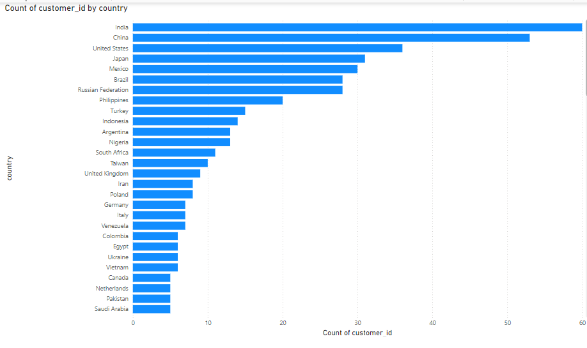
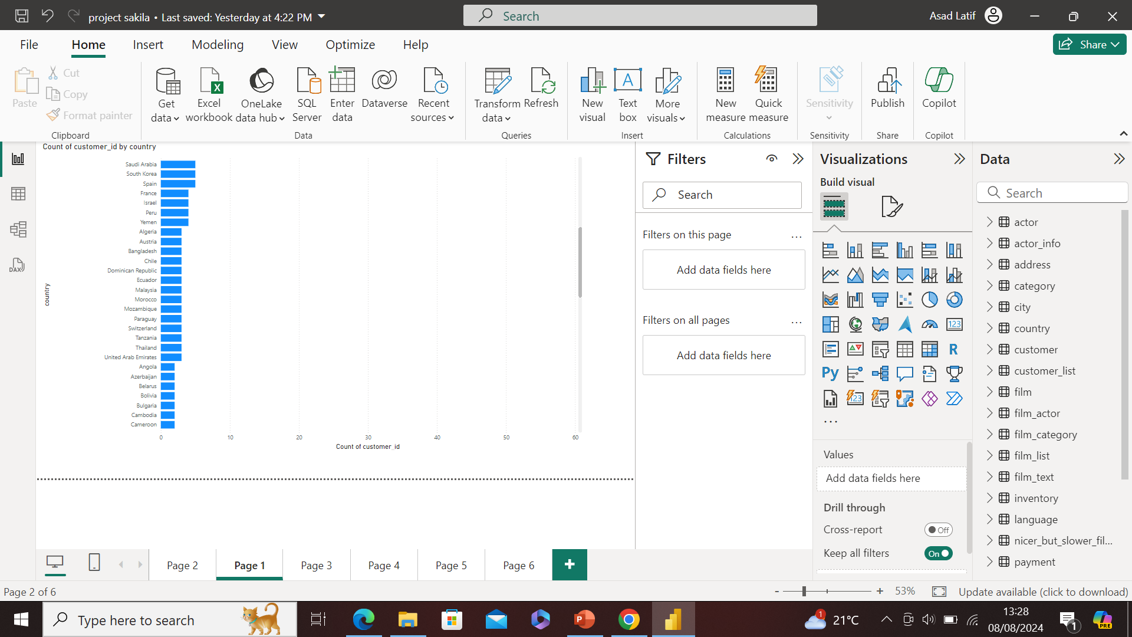
Customer Distribution by Country
This bar chart visualizes the distribution of customers by country, with the count of customer IDs on the x-axis and the countries listed on the y-axis. Here are some brief key insights:
Top Countries: India leads with the highest number of customers, followed closely by China and the United States. These three countries dominate the customer base.
Geographic Patterns: Most customers are concentrated in large, populous countries such as India, China, and the United States, reflecting a significant market presence in these regions. There is a noticeable drop in customer numbers as we move towards less populated or smaller countries like Saudi Arabia, Pakistan, and the Netherlands.
This distribution suggests that Cinemax Rentals has a strong foothold in major markets, but there may be opportunities for growth in regions with fewer customers.

Slide 4
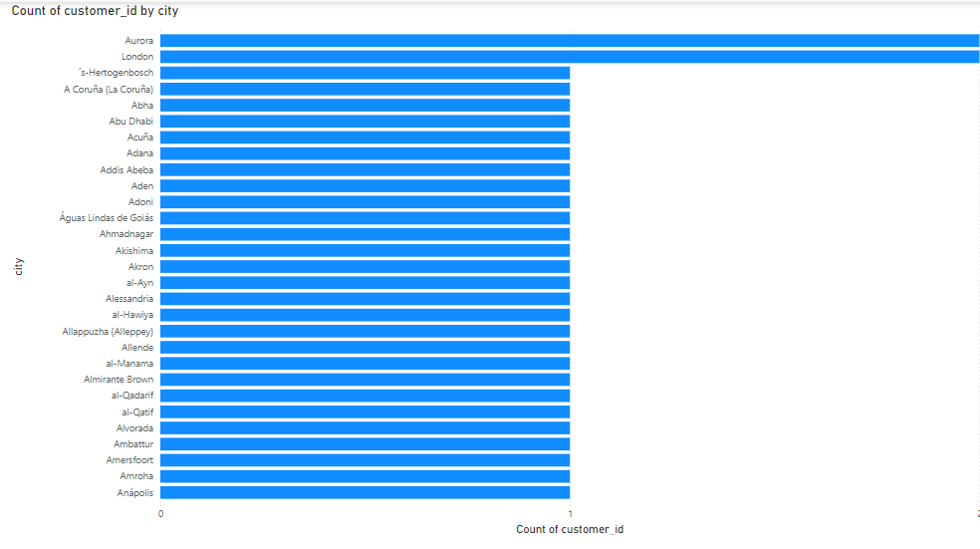
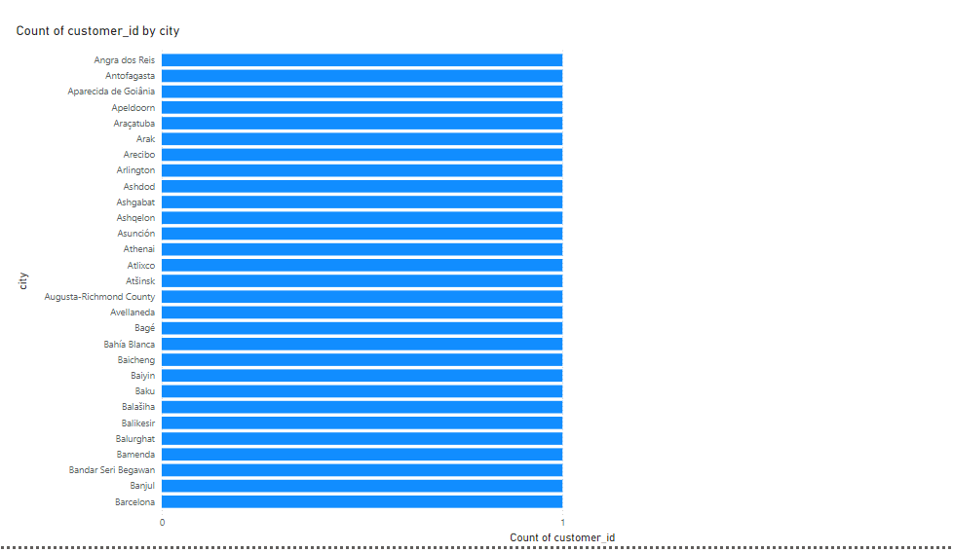
Customer Distribution by City
This bar chart represents the distribution of customers by city, with the count of customer IDs plotted on the x-axis and cities listed on the y-axis. Here are some key observations:
Customer Distribution: Each city appears to have a relatively small and nearly identical customer base, indicating a widespread but evenly distributed market presence.
No Dominant City: Unlike the country-level distribution, there are no standout cities with significantly higher customer counts. This suggests that Cinemax Rentals' customer base is well-dispersed across various cities, without any urban area dominating in terms of customer concentration.
The uniformity in customer counts across cities might indicate a strategy that focuses on broad market penetration rather than concentrating resources in a few key metropolitan areas.

Slide 5
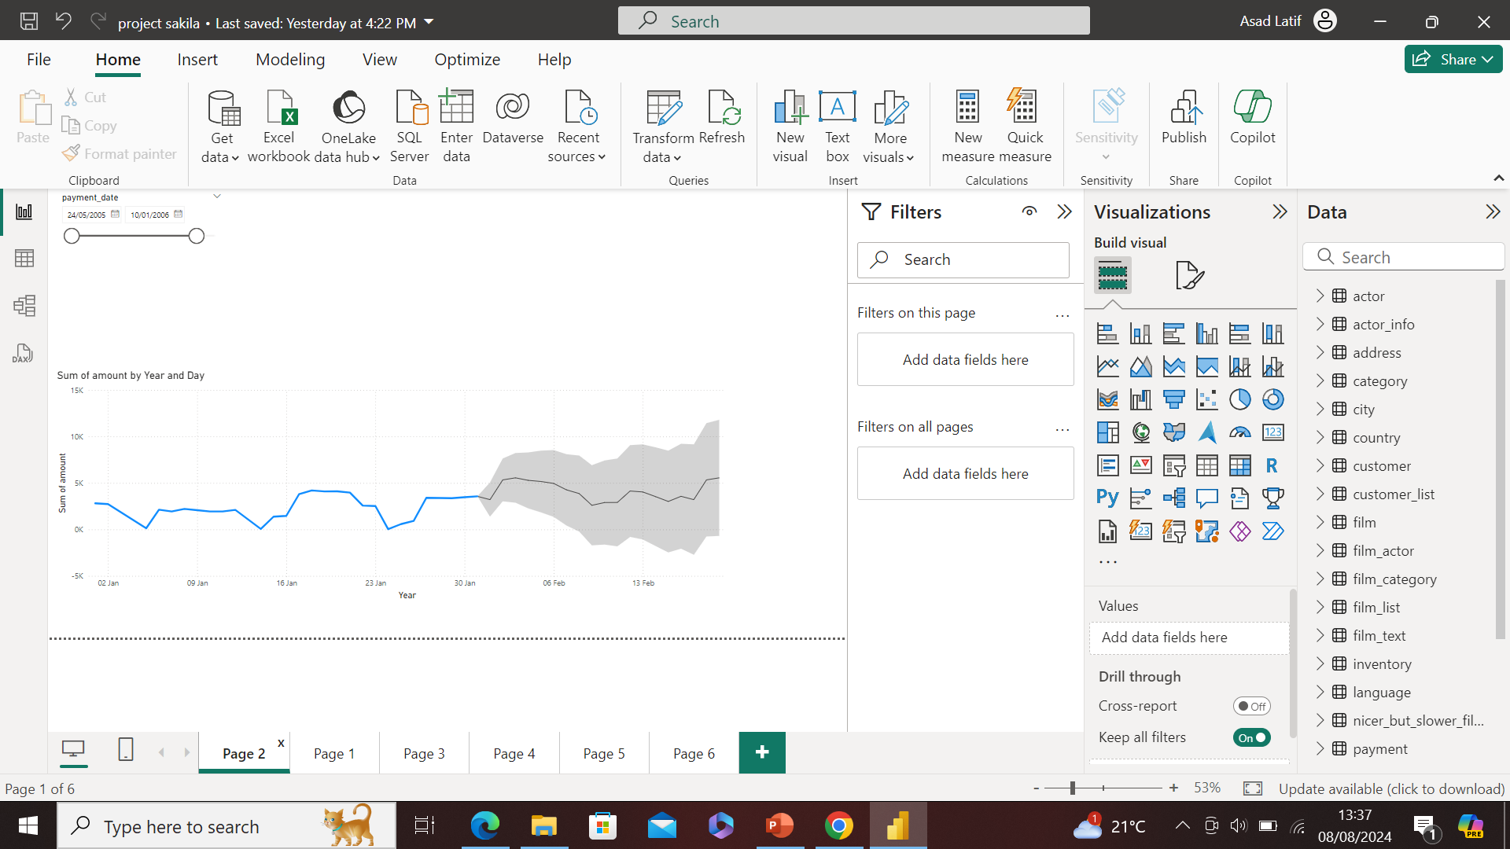
Revenue Forecast
Sum of Amount by Year and Day (Forecast):
Description: This line chart with a forecast shows the sum of amounts (likely revenue) over time, with a prediction for the upcoming period. The grey area represents the confidence interval for the forecasted values.
Business Insight: Use this forecast to plan resource allocation, inventory management, and promotional activities for the upcoming quarter. Any dips in the forecast should prompt an investigation into potential causes, while upward trends should be leveraged for maximizing revenue.

Slide 6
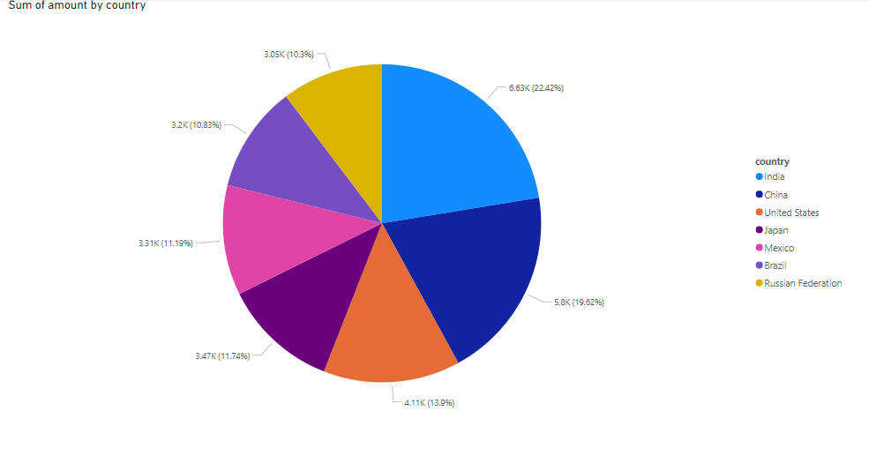
Top 7 Revenue-Generating Countries
Overview:
Pie chart visualizes revenue shares by country.
Top Contributors: India (22.4%), USA (18.3%).
Key Observations:
Strong Markets: India and USA dominate revenue, indicating robust sales.
Significant Shares: China (12.6%), Japan (11.9%), and Mexico (10.3%).
Strategic Insights:
Focus Areas: Prioritize marketing and resource allocation in top-performing countries.
Growth Potential: Examine lower-performing regions for targeted improvements.
Actionable Steps:
Boost efforts in strategic markets to maximize revenue.
Tailor strategies in underperforming areas to increase market share.

Slide 7
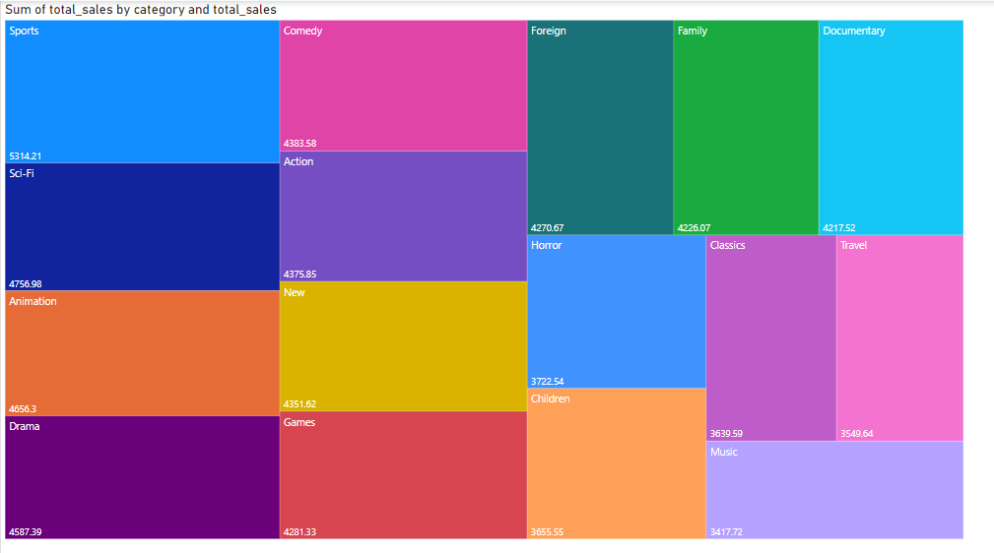
Total Sales Overview
Business Insight:
Top Performers: 'Sports' and 'Comedy' are the leading categories in terms of sales volume, suggesting they are key revenue drivers. Focus on maintaining or enhancing marketing efforts in these categories to sustain or grow their market share.
Significant Contributors: 'Action' and 'Animation' also contribute substantially to total sales. Consider investing in these categories for promotional activities or product expansions to further capitalize on their success.
Moderate Sales Categories: 'Horror', 'Family', 'Documentary', 'Classic', and 'Travel' generate moderate sales. Evaluate opportunities for growth through targeted campaigns or special promotions.
Smaller Categories: 'Children', 'Drama', 'Games', 'Music', and 'Sci-Fi' have smaller sales volumes. Investigate these categories to identify potential for increased sales, which might include exploring new market segments or adjusting pricing strategies.

Slide 8
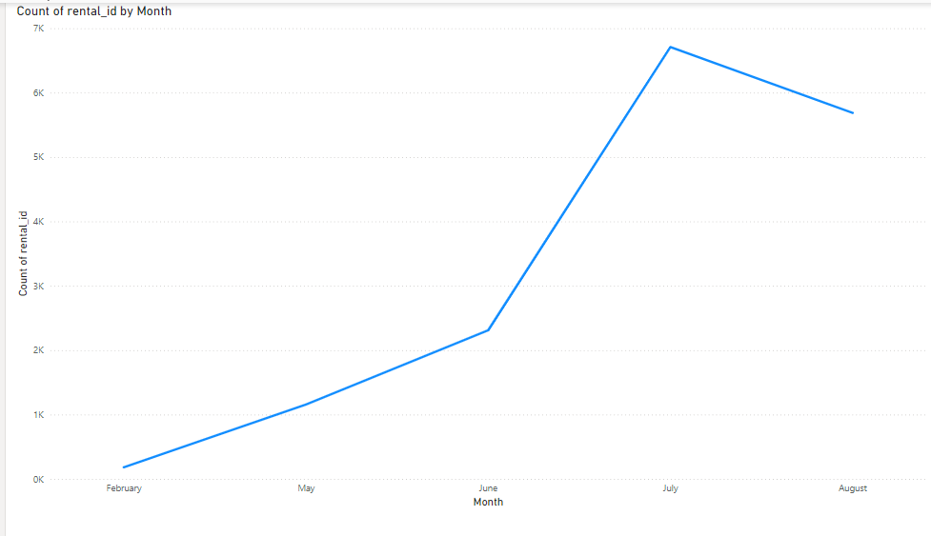
Rental Trends by Month
Key Insights:
Busiest Months: Peaks in the graph indicate high rental activity, often during summer or holiday seasons.
Slowest Months: Dips in the graph highlight periods of lower rental activity, typically post-holiday or during winter.
Seasonal Trends: Identifies recurring patterns of high and low rental periods, suggesting seasonal influences on rental behaviour.
Actionable Strategies:
Peak Periods: Ensure adequate inventory and staff; consider targeted marketing.
Off-Peak Periods: Implement promotions or special offers to boost rentals.
Seasonal Planning: Adjust marketing and resource allocation based on identified trends.
This analysis helps optimize rental strategies by understanding and responding to seasonal demand fluctuations

Slide 9
Actionable Recommendations
1. Customer Engagement: Boosting Engagement in Top Cities
Target Key Markets: Focus on cities with the highest rentals; offer city-specific promotions.
Local Events: Host movie nights or film festivals to build community and loyalty.
Digital Engagement: Personalized recommendations, tiered loyalty programs, and social media campaigns.
2. Inventory Management: Balancing Film Inventory Across Stores
Demand Forecasting: Use historical rental data to predict demand and adjust inventory accordingly.
Dynamic Allocation: Implement a system to shift inventory between stores based on real-time demand.
Diverse Catalogue: Ensure a mix of new releases and popular classics tailored to each location.
3. Promotions: Targeted Campaigns During Low-Rental Months
Seasonal Discounts: Offer discounts during historically slow periods to stimulate rentals.
Bundling Offers: Create bundle deals (e.g., "Rent 2, Get 1 Free") to increase transaction size.
Thematic Promotions: Align promotions with holidays or local events to drive interest.
4. Revenue Growth: Capitalizing on High-Contributing Customer Groups
Premium Memberships: Introduce premium tiers with added benefits like early access to new releases.
Referral Programs: Encourage top customers to refer friends with rewards for both.
Upselling Opportunities: Promote higher-margin products (e.g., movie merchandise) to top spenders.

